Slide 1
Hardware.Astronomy Housekeeping Box (h.aHKBox) Chassis
As Worked On By Adam Stammer

Slide 2
Project Goal
To design and build an open source, modular Eurocard system to be used as astronomical control/housekeeping equipment
To replace existing ZEUS2 housekeeping equipment with a cheaper, simpler, more robust system
My Goals
- Design Prototyping Daughtercard (P-Card) to aid in development
- Design Eurocard Backplane to connect and control modular cards
- Choose Power Supplies
- Put it all together in the case
- Program Controllers as foundation for card interaction
Context
Notes:
2

Slide 3
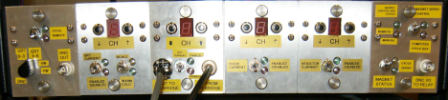
Existing Housekeeping Equipment

Slide 4
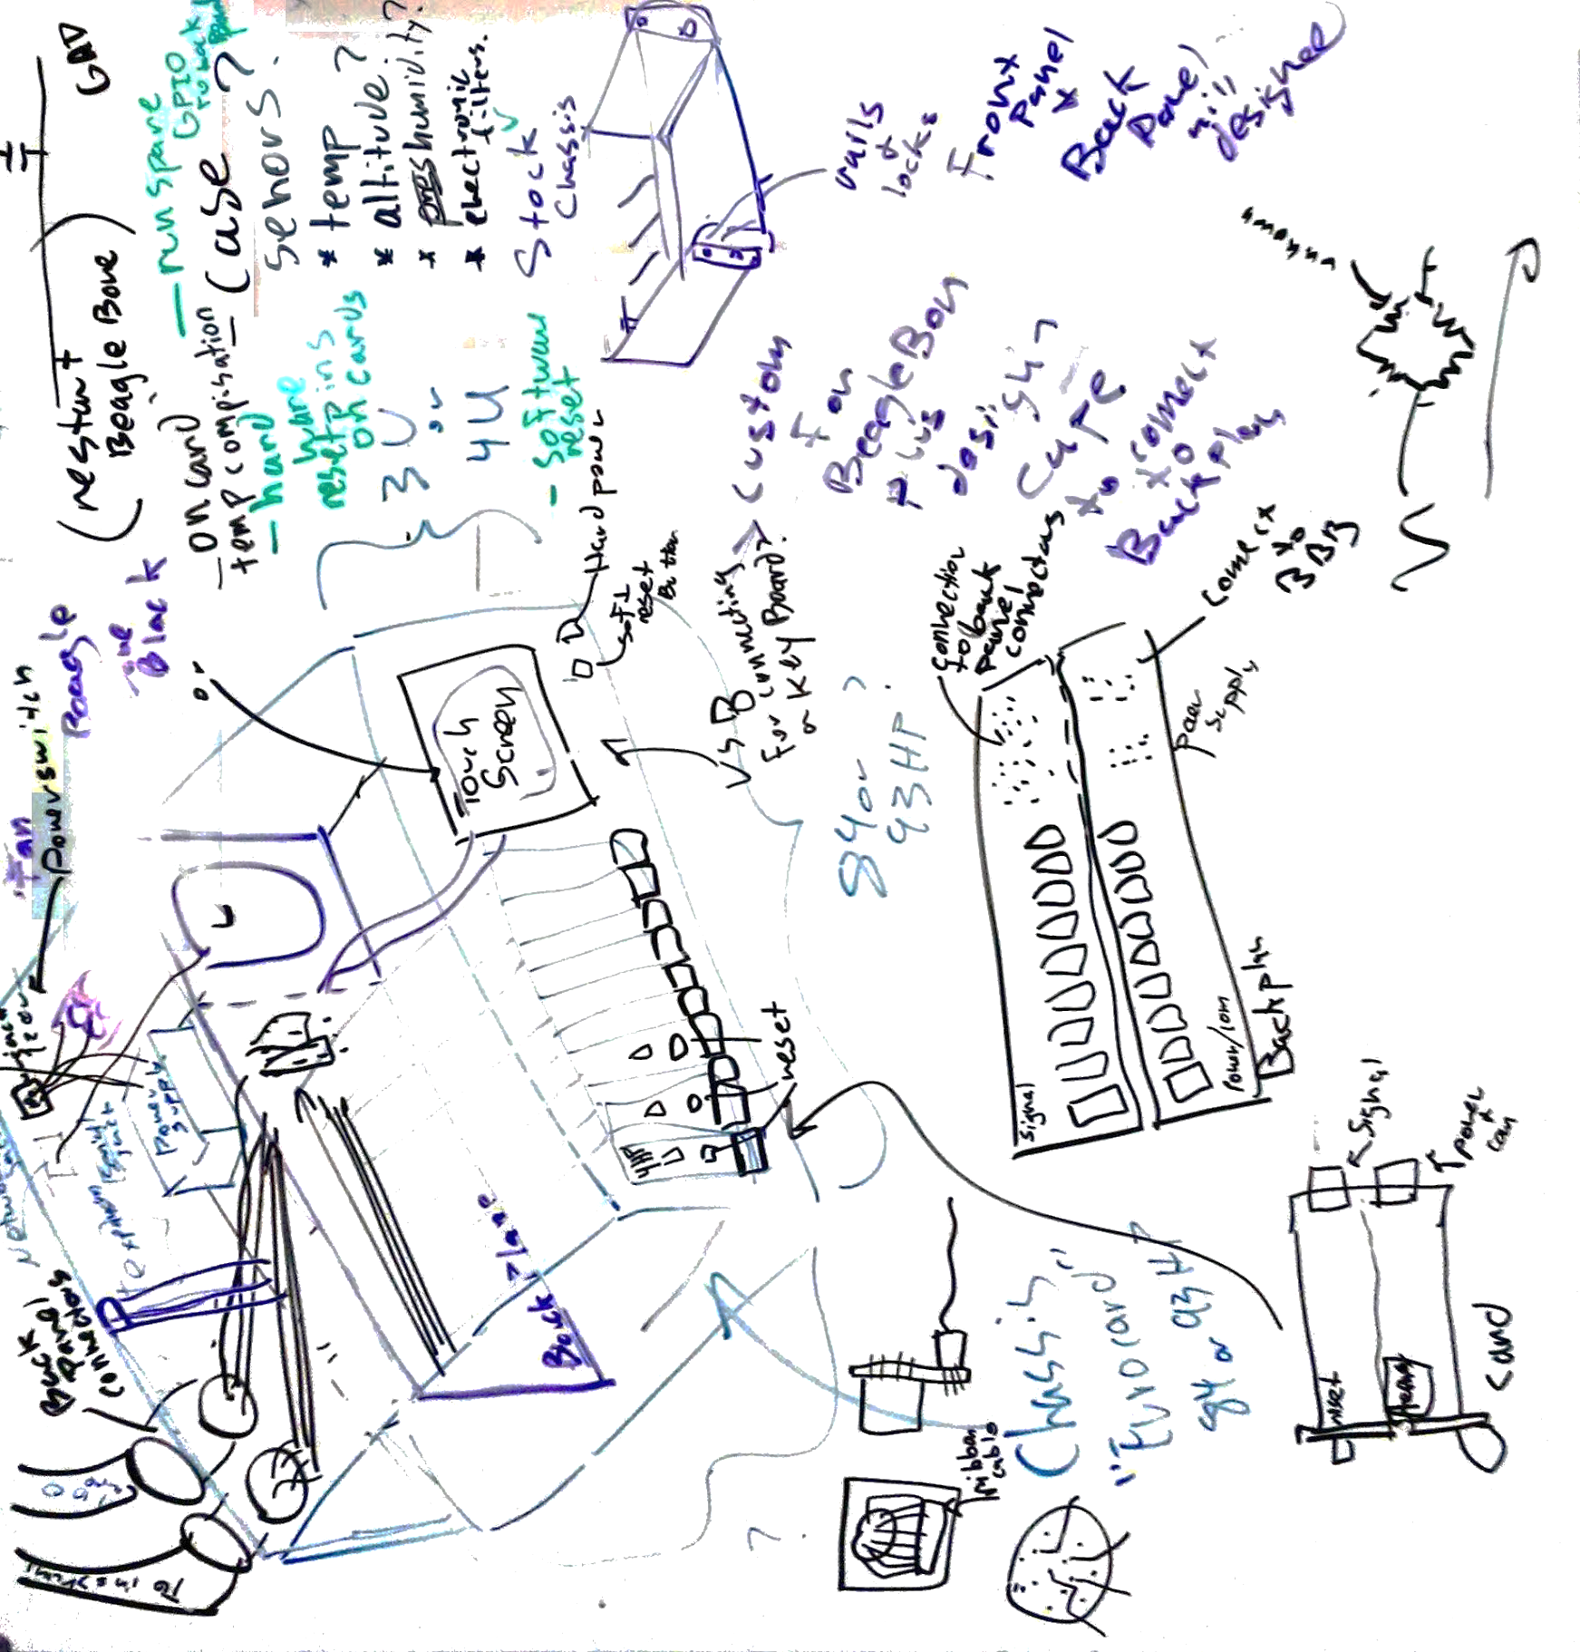
Whiteboarding of the H.aHK Box

Slide 5
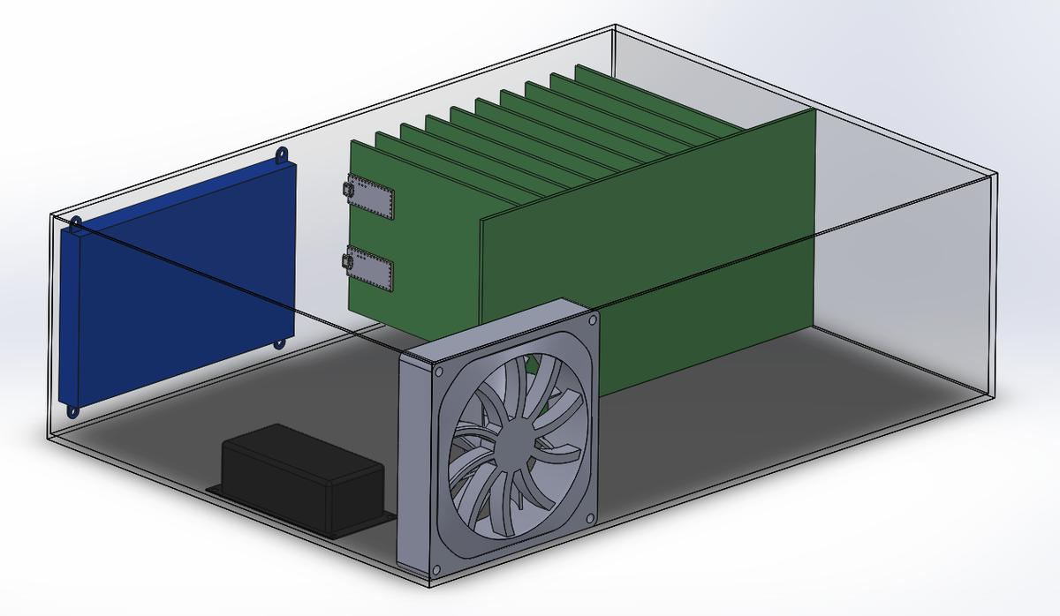
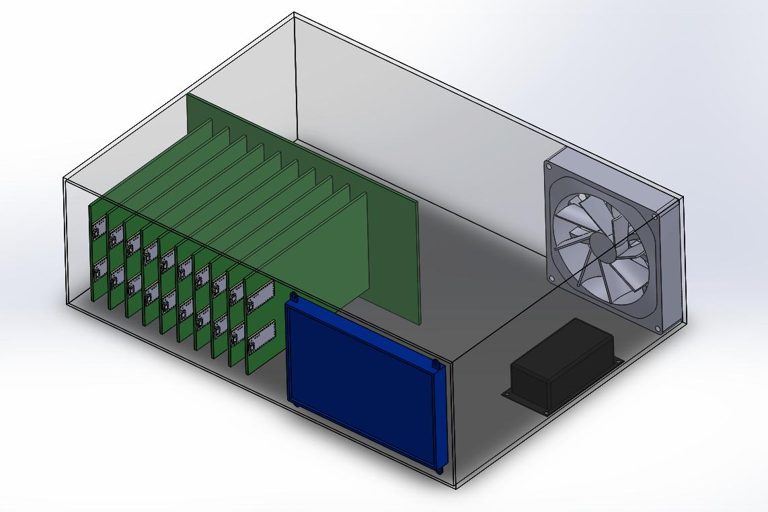
Draft model of H.aHK Box
Blue = touch screen
Black = power supply
Grey = cooling fan
Green = circuit boards (big is the bus, and slam are the cards)

Slide 6
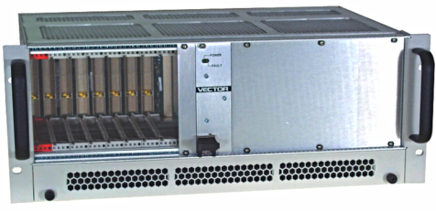
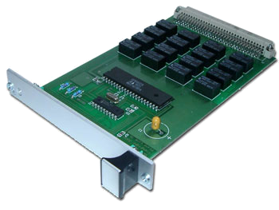
Device | Processor | RAM/ Storage | Other | Software | Ref.
Raspberry Pi 3 $39.95 | 64-bit 1.2 GHz ARM | 1 GB/ 32GB | 40GPIO, SPI, I2C, HDMI, 4 - USB, Ethernet, Serial | Debian Linux | [5]
Teensy 3.2 $19.80 | 72 MHz ARM Cortex-M4 | 64KB/ 256 KB | 34 GPIO, 21 ADC (13-Bit), Serial (3), SPI, I2C (2), | Arduino IDE | [6]
Similar cases and cards as the H.aHK Box as found commercially.

Slide 7
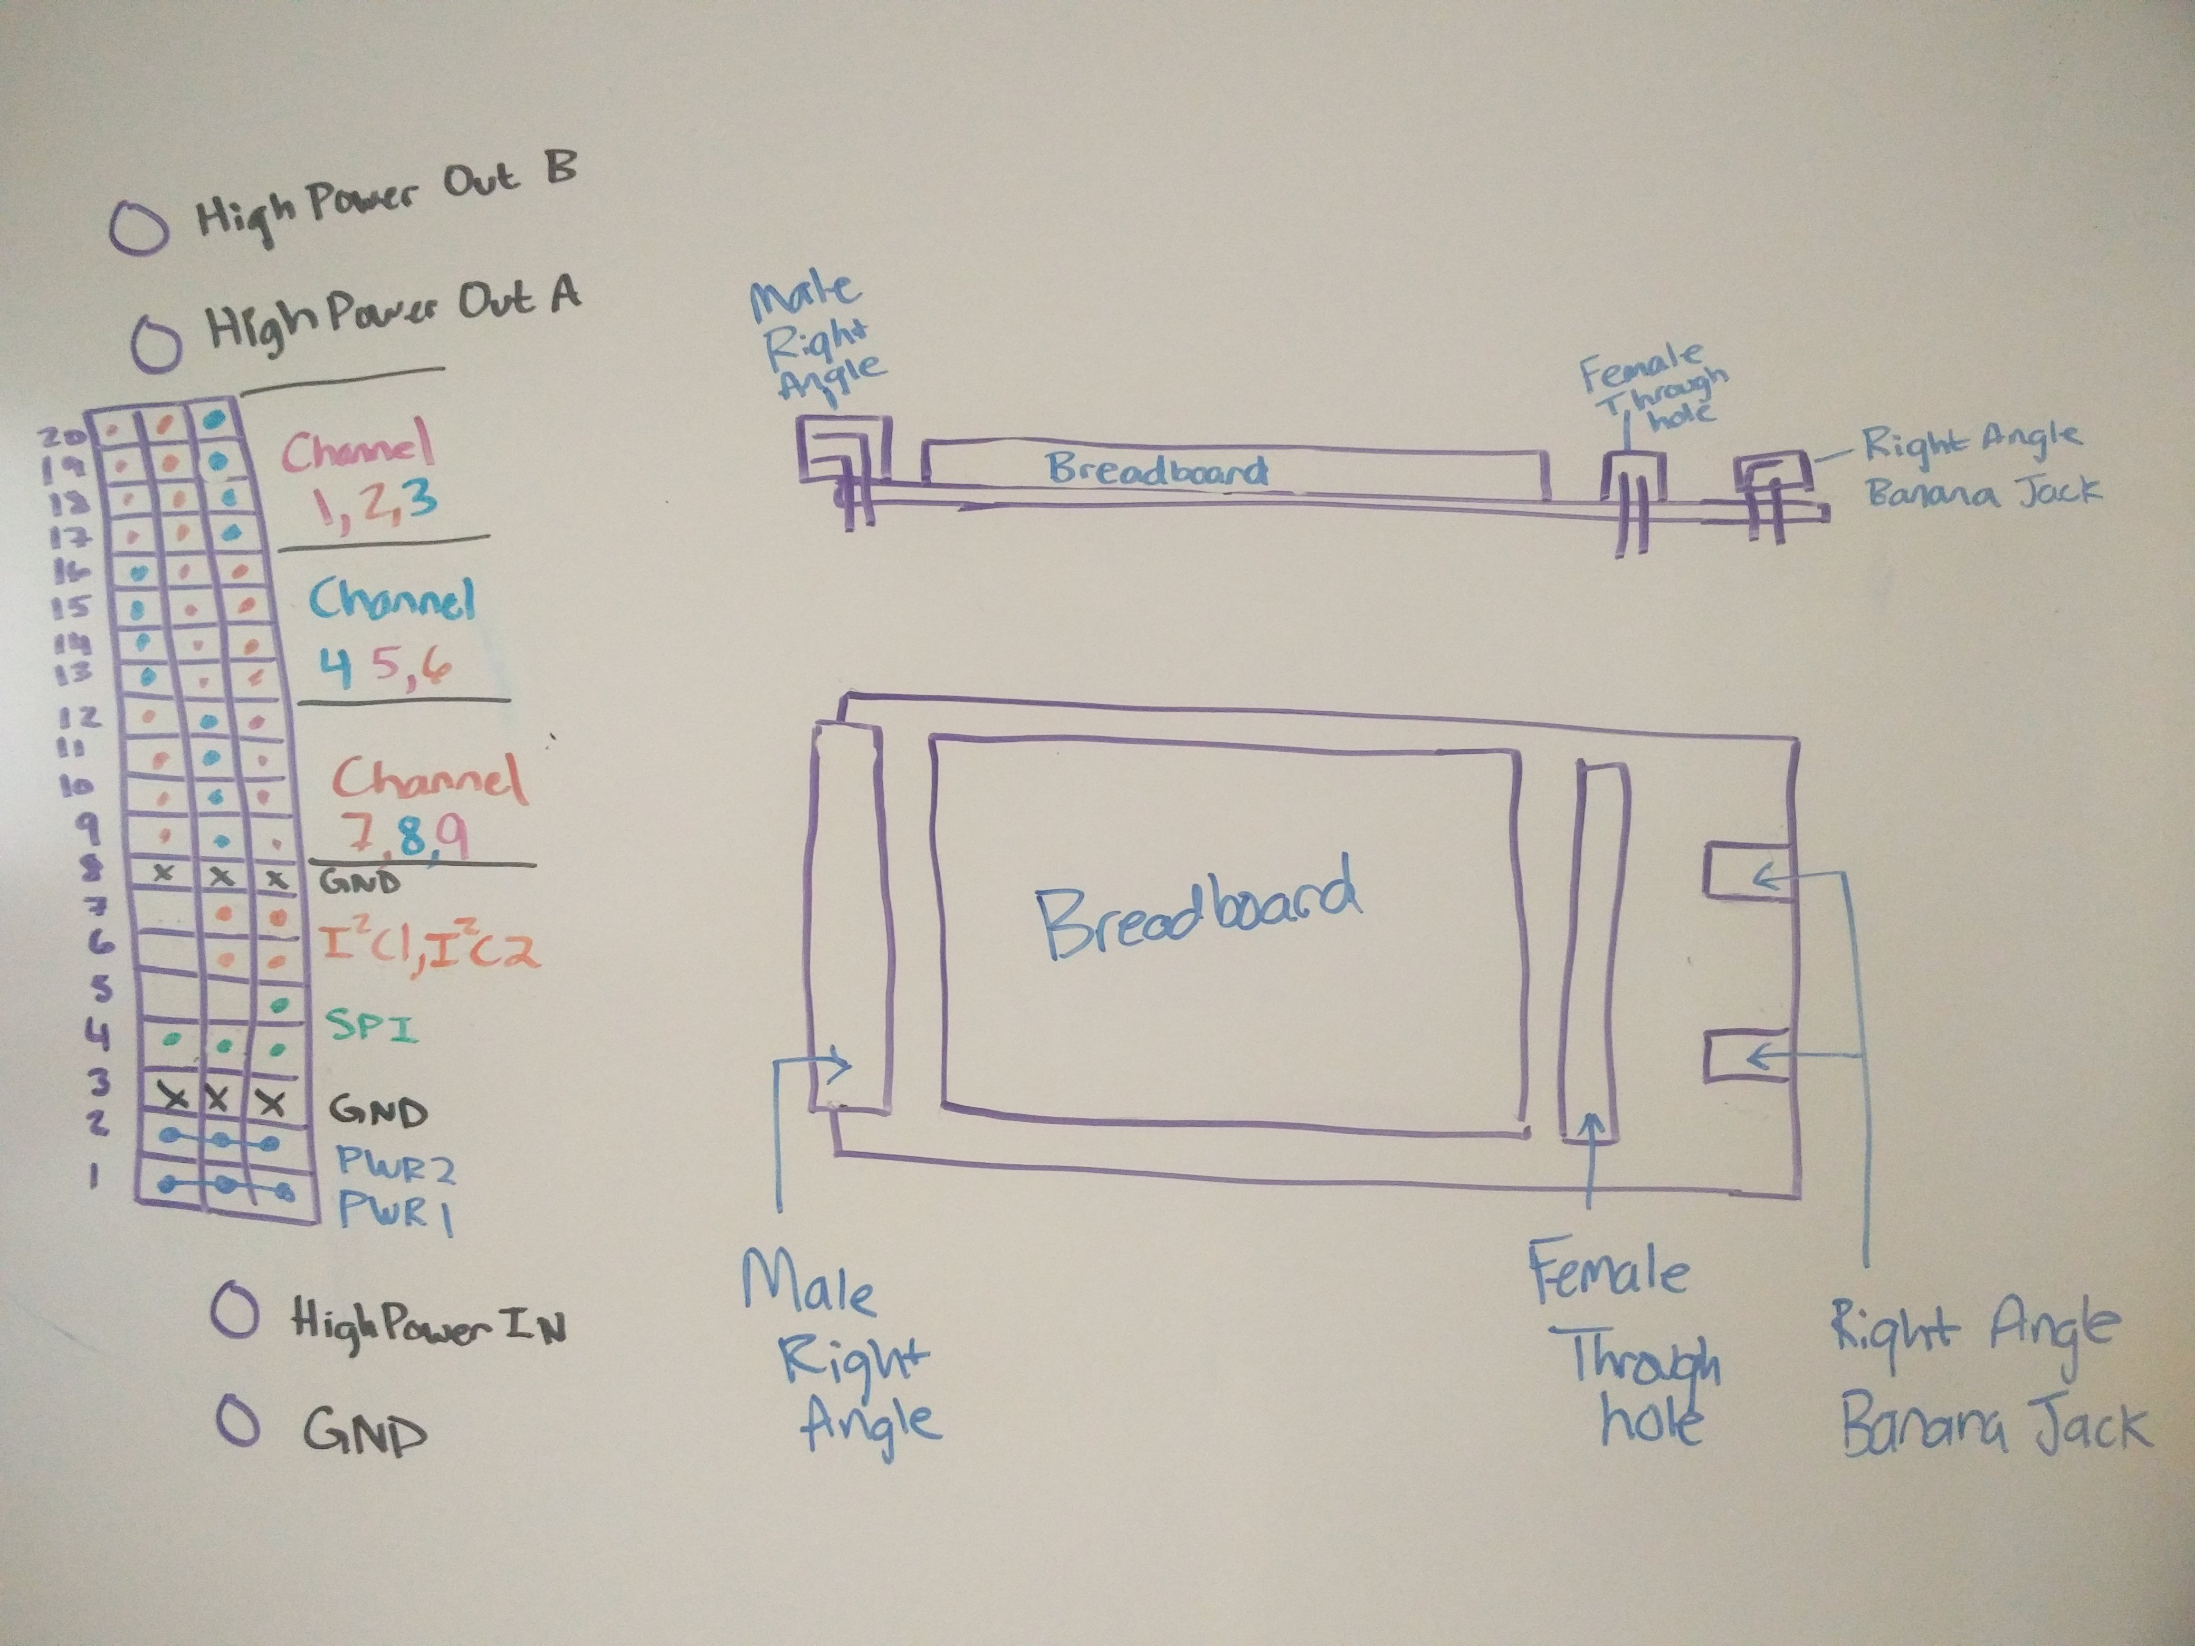
Male Socket, Female Socket, Breadboard, High Power Banana Jacks, Double Length For Easy Access
Prototyping Card (P-Card)
Sketch

Slide 8
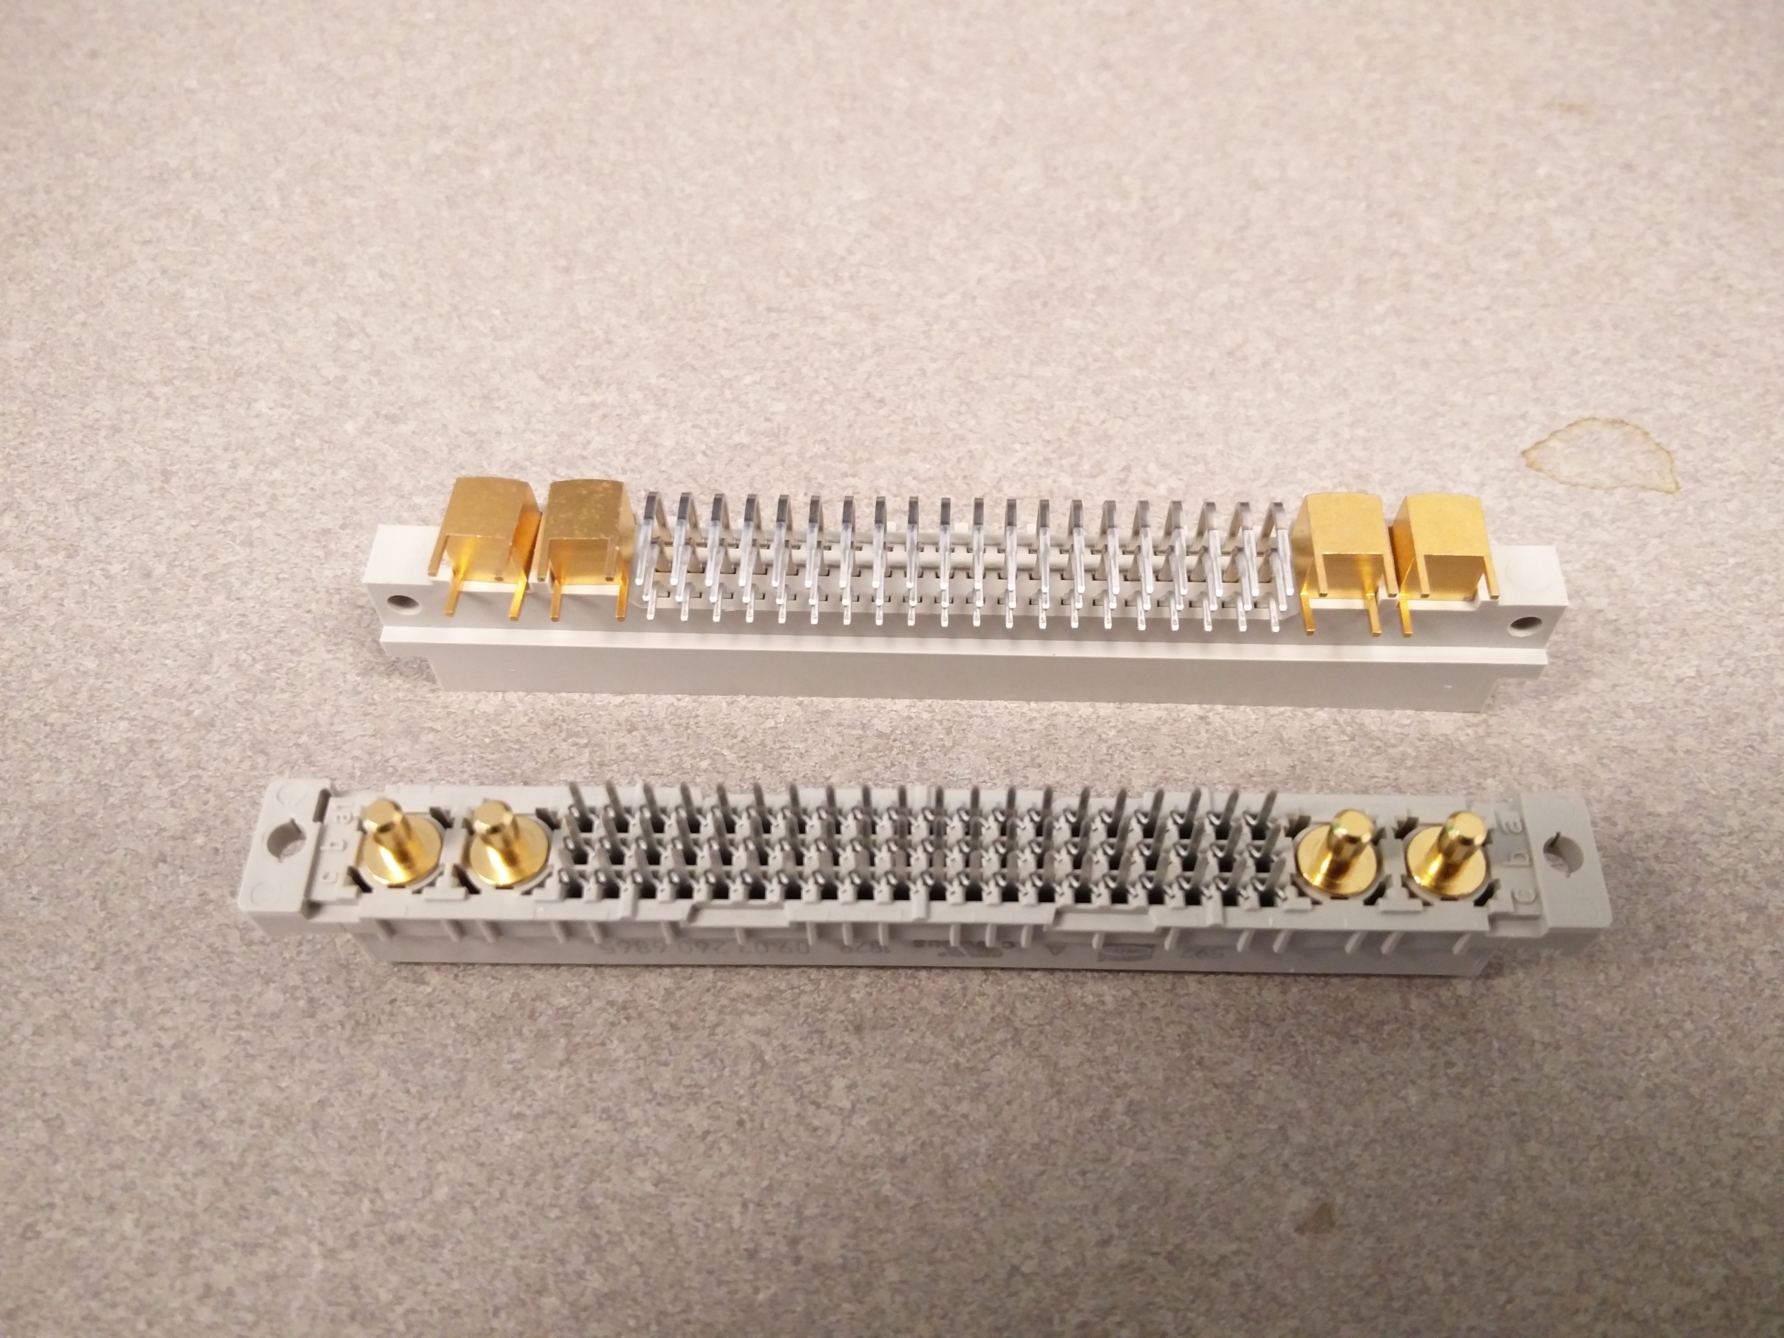
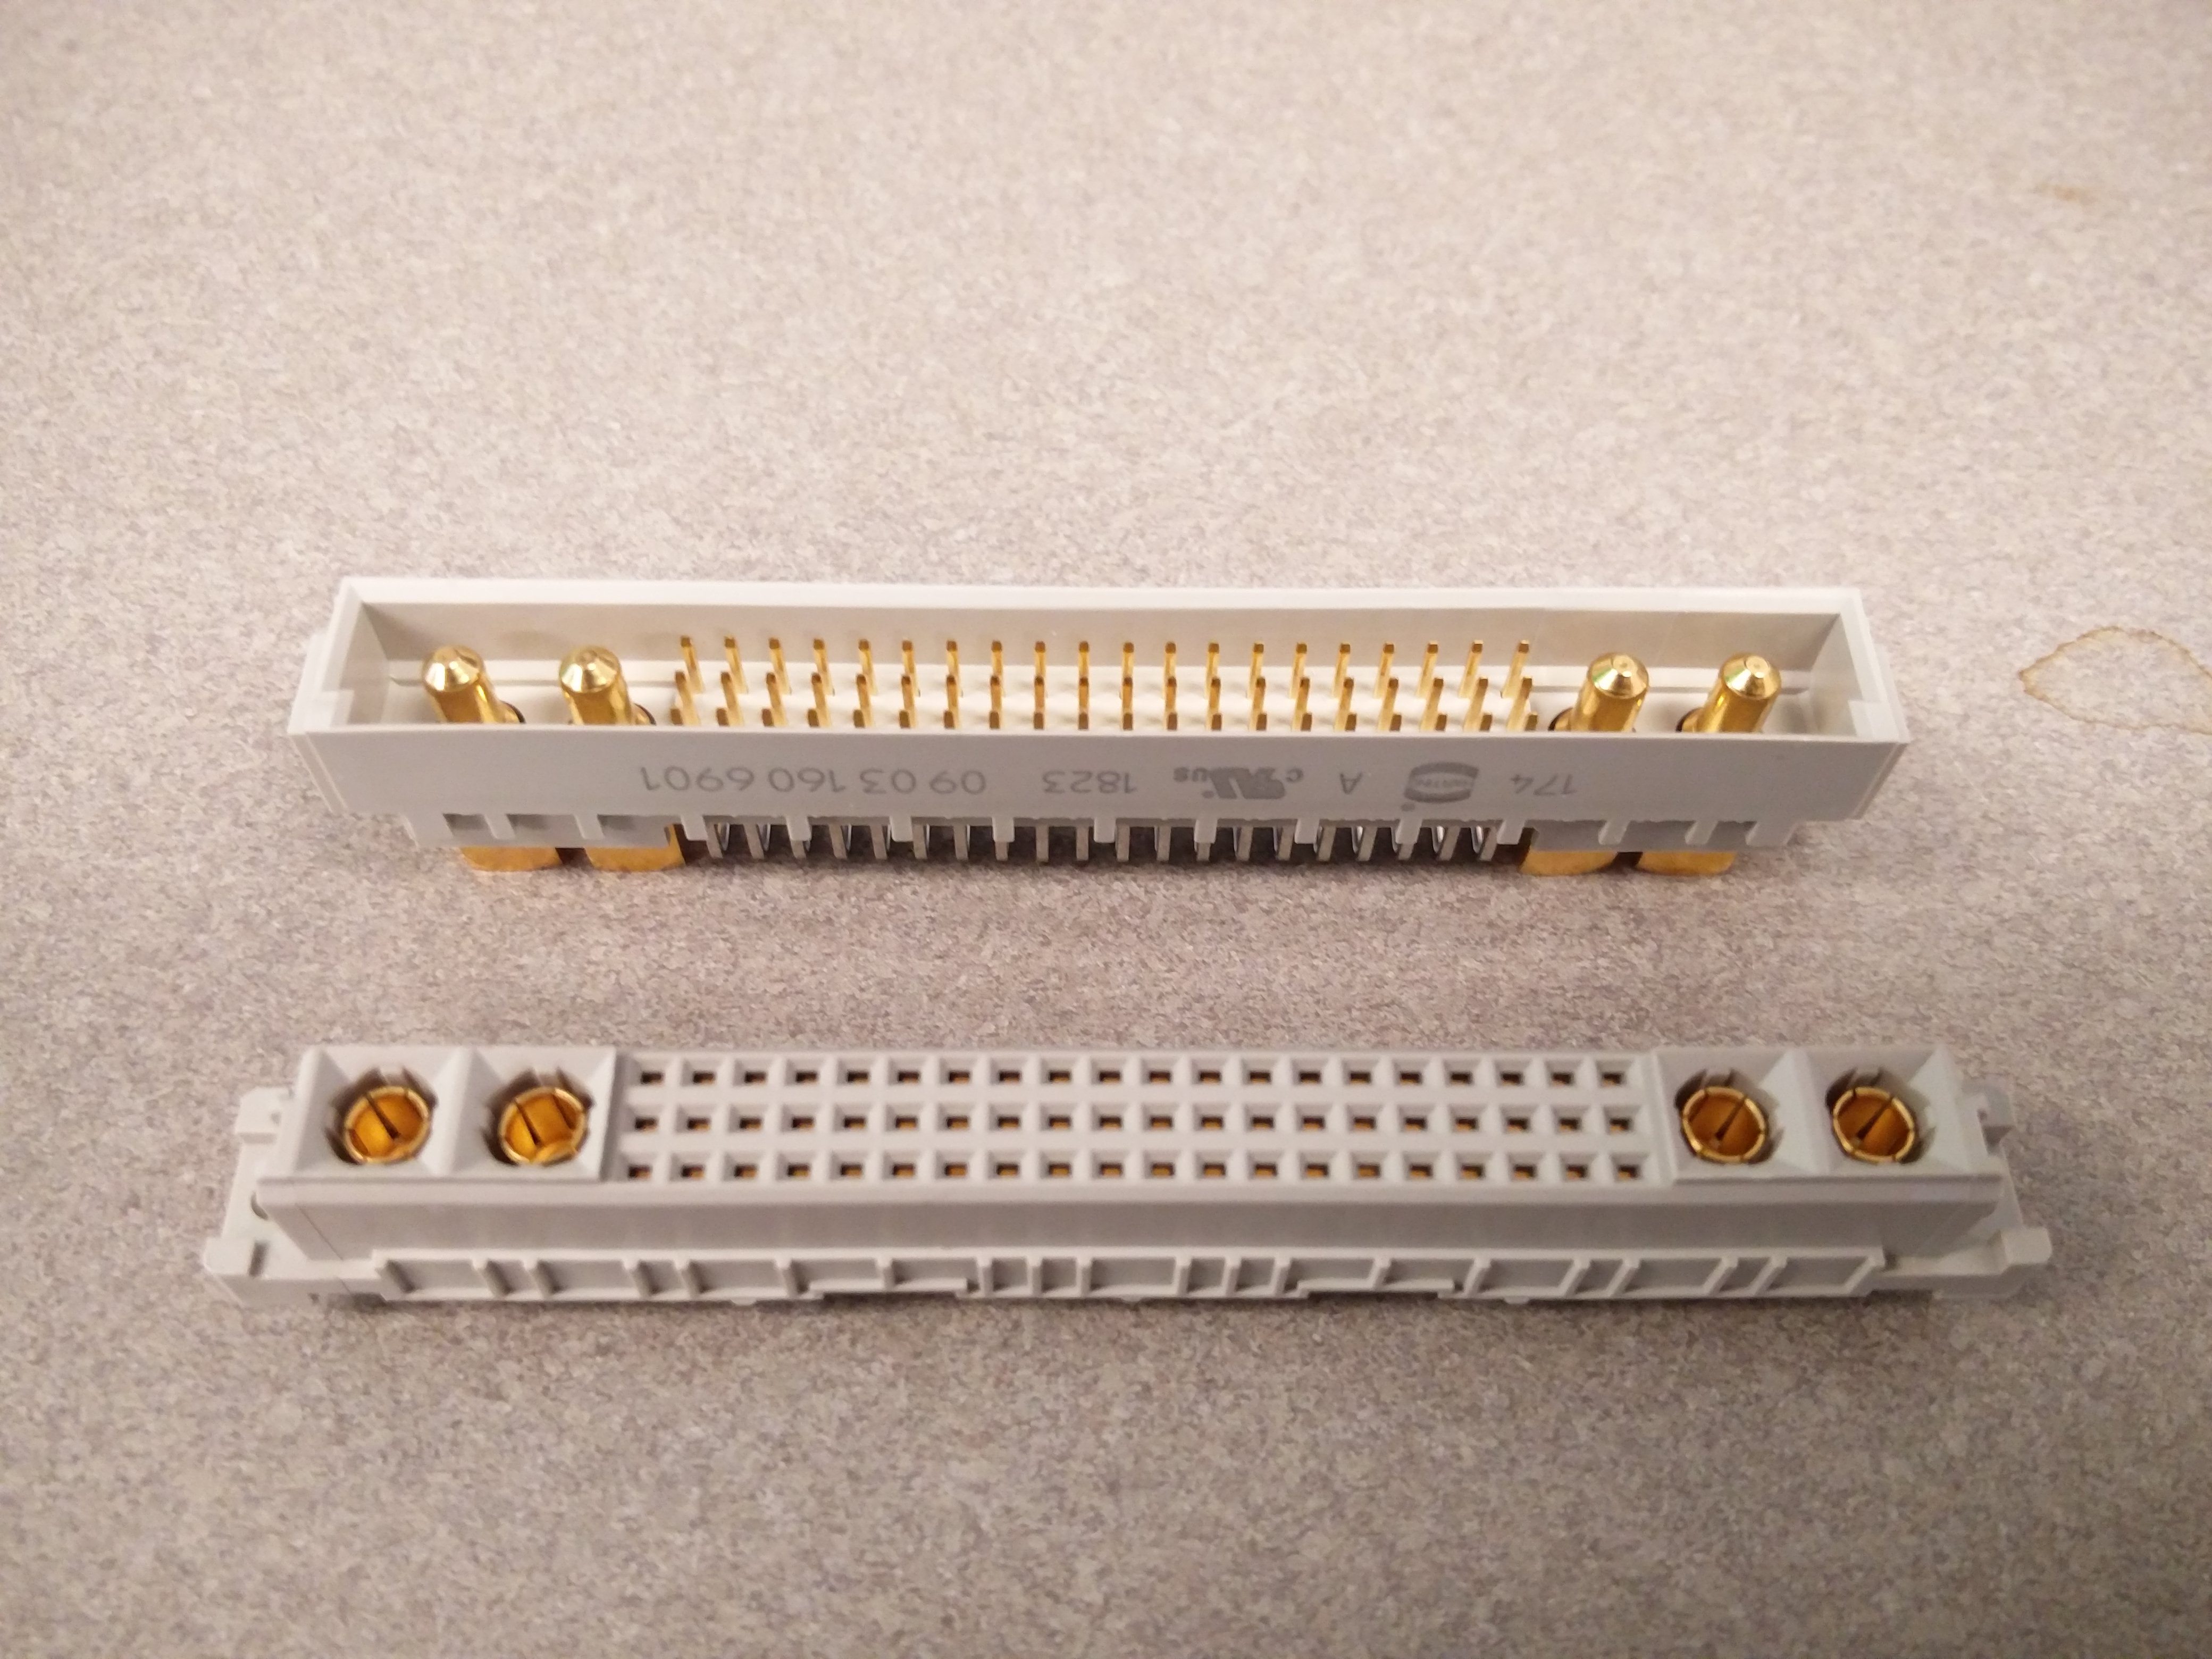
60 Pins @ 2 Amps and 4 High Current Pins @ 20 Amps
Sockets

Slide 9
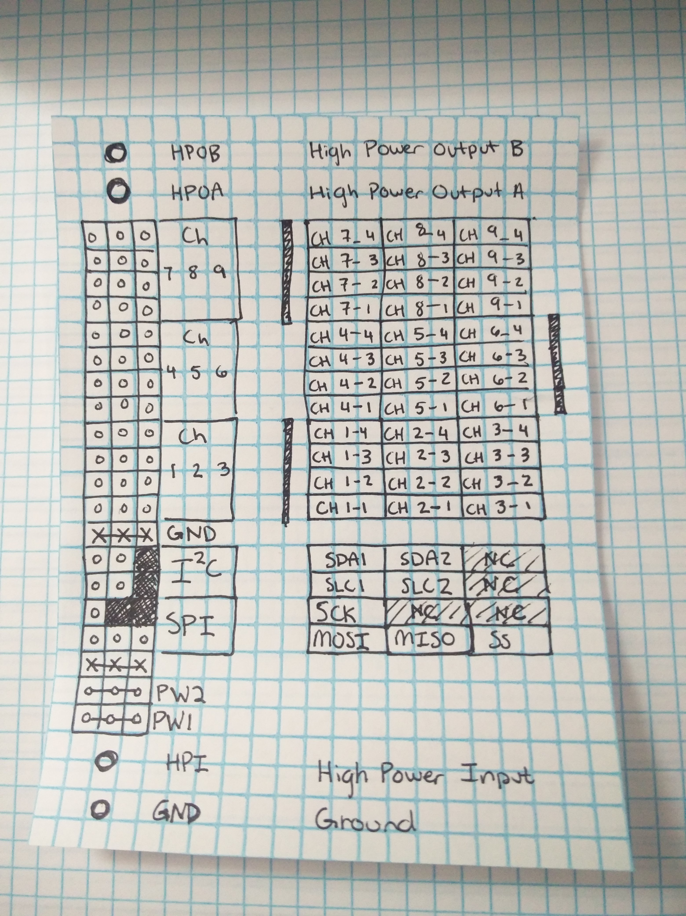
2 HP IO, 9 4pin IO Channels, 2 I2C Channels, 1 SPI Channel, Low Power Input, High Power Input, Ground
Socket Pinout

Slide 10
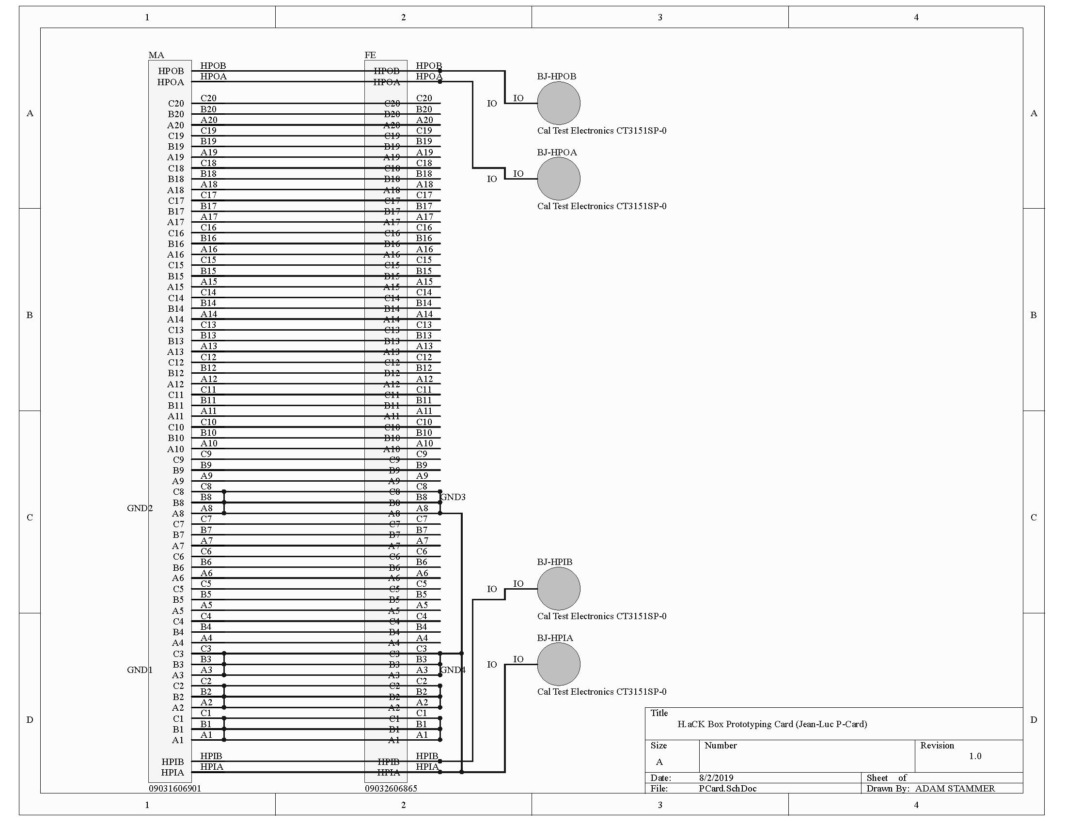
Male Socket, Female Socket, Breadboard, High Power Banana Jacks, Double Length For Easy Access
Prototyping Card (P-Card)

Slide 11
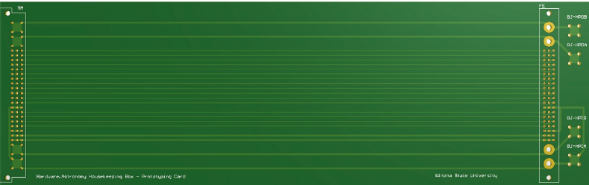
Male Socket, Female Socket, Breadboard, High Power Banana Jacks, Double Length For Easy Access
Prototyping Card (P-Card)

Slide 12
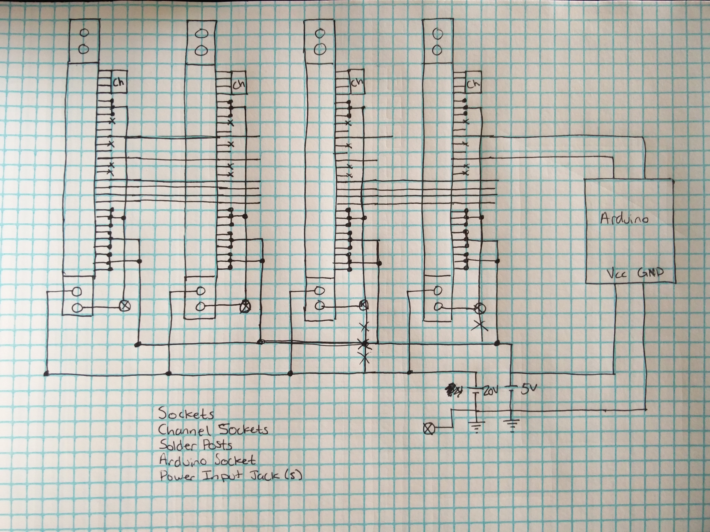
Sockets, Power, SPI, HP Signal I/O, 9 4-pin signal I/Os per card, Arduino Controller (with I2C), On board Temperature Sensors, 7-segment digit display, 5Volt and 20Volt Power, Raspberry Pi (with I2C), Interrupts from Arduino and Pi
Backplane
Simplified
Schematic
Sketch

Slide 13
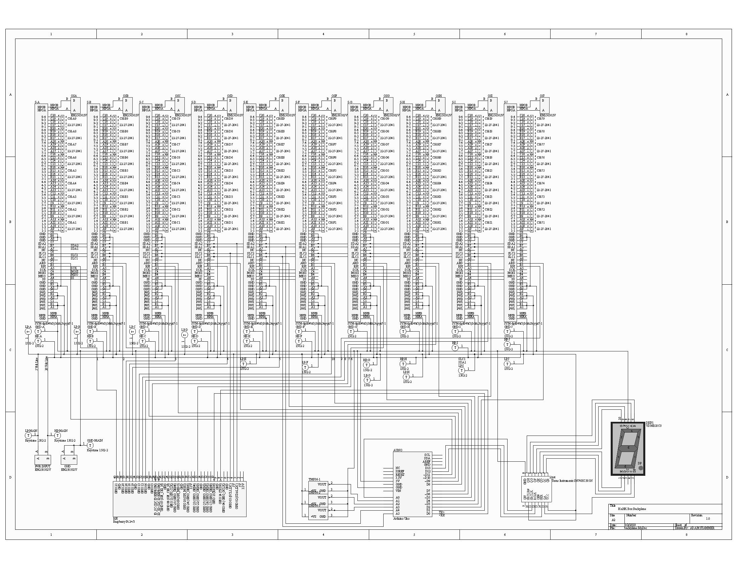
Sockets, Power, SPI, HP Signal I/O, 9 4-pin signal I/Os per card, Arduino Controller (with I2C), On board Temperature Sensors, 7-segment digit display, 5Volt and 20Volt Power, Raspberry Pi (with I2C), Interrupts from Arduino and Pi
Backplane
Schematic

Slide 14
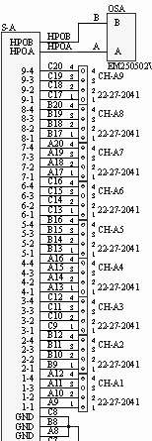
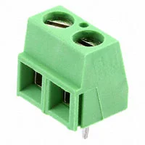
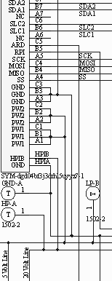
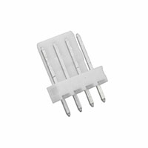
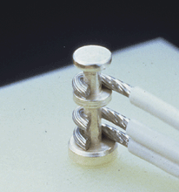
Sockets, Power, SPI, HP Signal I/O, 9 4-pin signal I/Os per card, Arduino Controller (with I2C), On board Temperature Sensors, 7-segment digit display, 5Volt and 20Volt Power, Raspberry Pi (with I2C), Interrupts from Arduino and Pi
Backplane
Schematic
Closeup
A
B
C

Slide 15
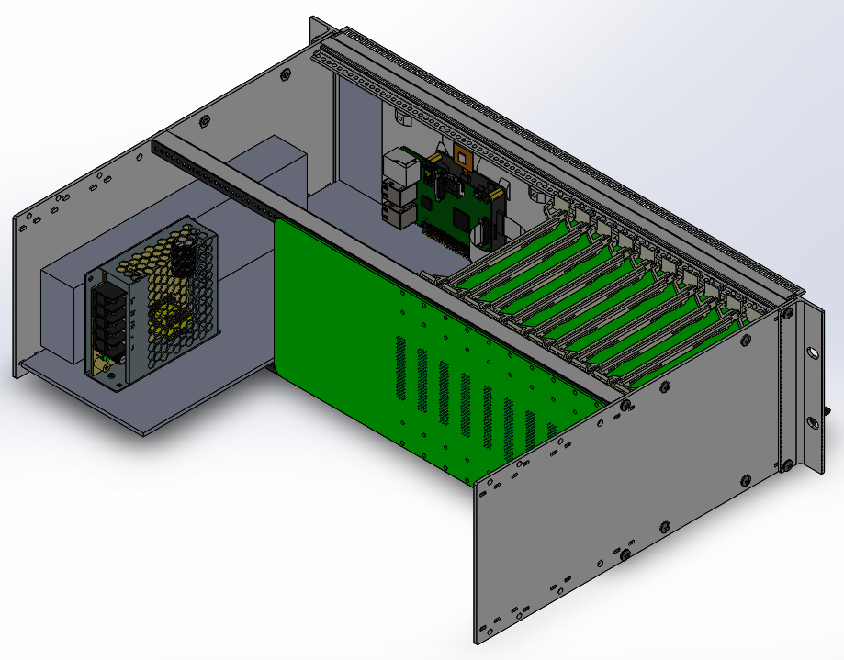
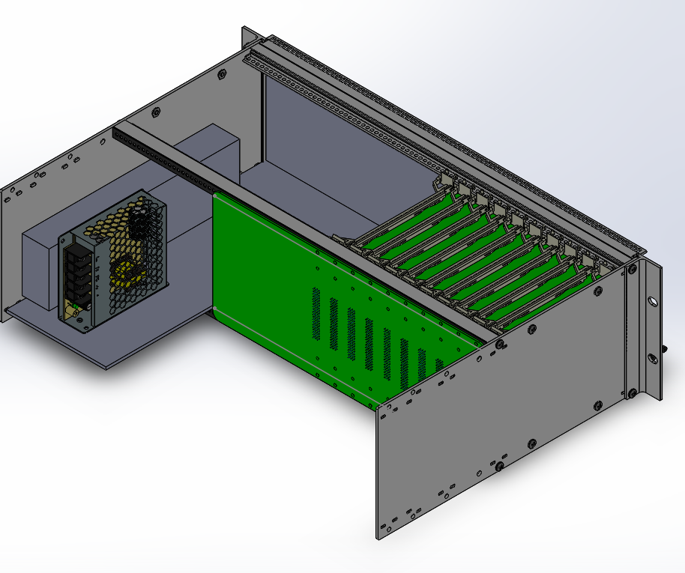
Chassis Render
Back

Slide 16
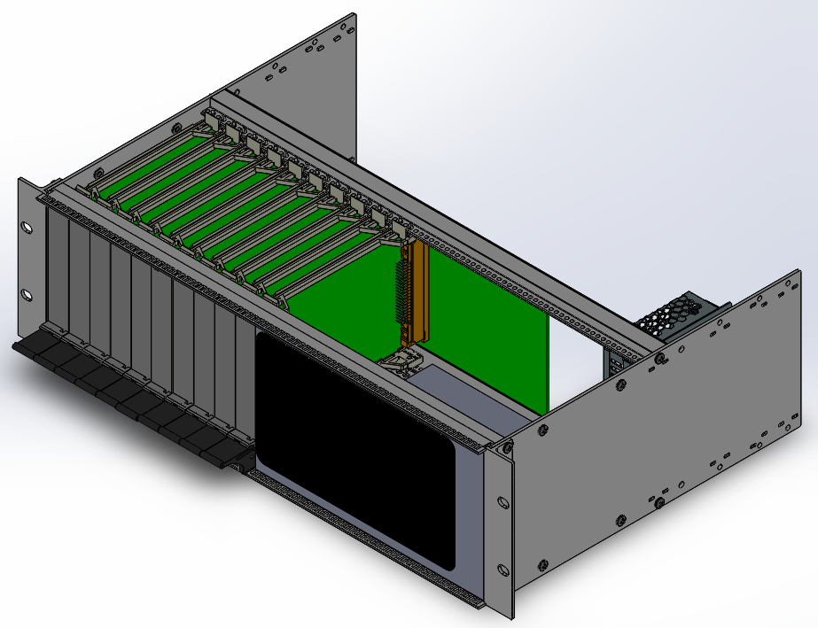
Chassis Render
Front

Slide 17
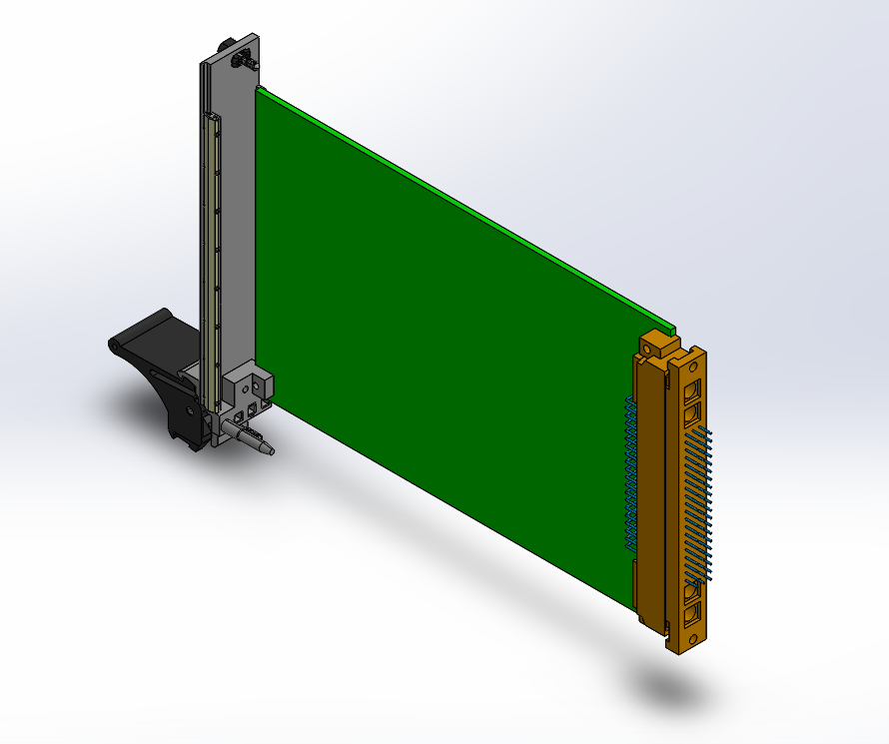
Card Render

Slide 18
Finish Technical Guide
- Summarize completed work
- Guide future designers and end users
Finish Backplane PCB Layout
Build and Test Everything
Program Controllers
Design/Build Cards
Next Steps

